Slide 1
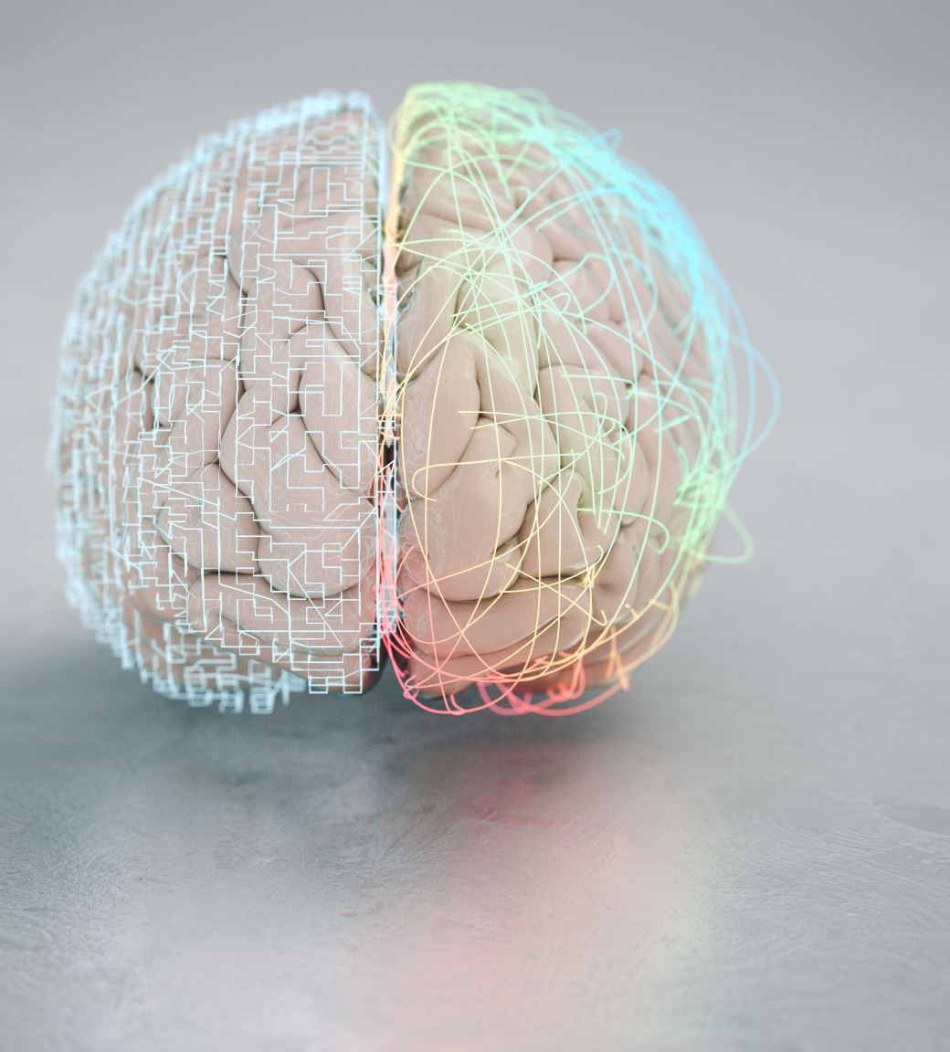
Brain Disease Classification (not tumor)
BY:-
2100031723

Slide 2

Problem statement : -
Creating an automated system for Brain Disease Classification from medical imaging data, specifically focusing on diseases other than tumors.

Slide 3
Data Description:-
Input data:-
MRI Scans:
Capturing different aspects of brain tissue and abnormalities.
Optionally, include CT scans to diversify imaging modalities.
Data Labels:
Mild Demented
Moderate Demented
non Demented
Very Mild Detemnted

Slide 4
Preprocessing of Data:-
Ensure consistent voxel sizes across different scans.
Resample images to a standard voxel resolution to create uniformity in the dataset.
This helps in reducing computational complexity during training.
Normalize the pixel intensity values across images.
Adjust intensity ranges to a standardized scale (e.g., [0, 1] or [-1, 1]).
Minimize variations in intensity due to different imaging devices or settings.

Slide 5
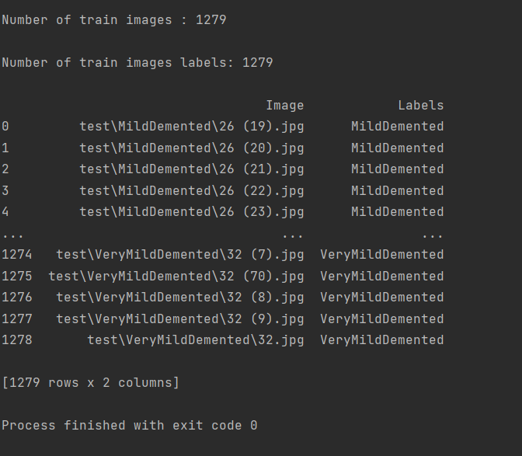
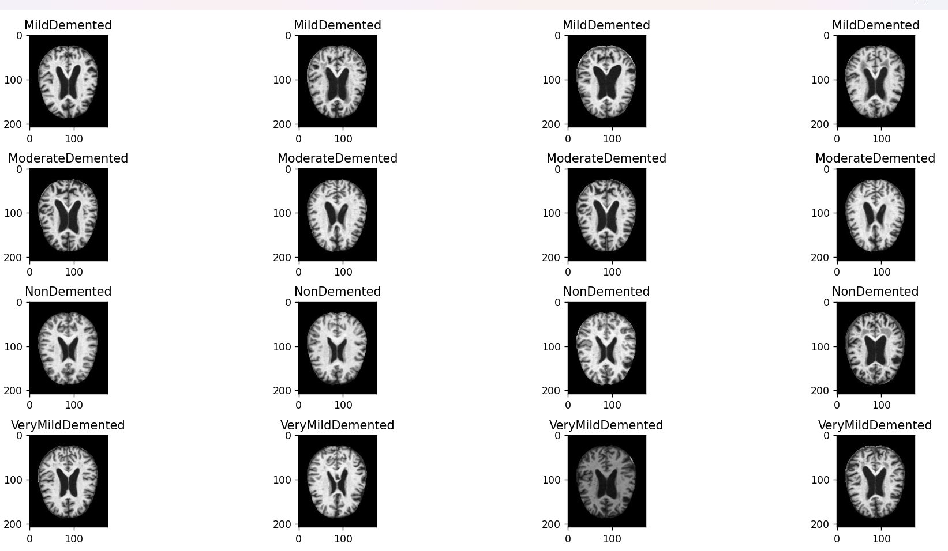
Outputs:-

Slide 6
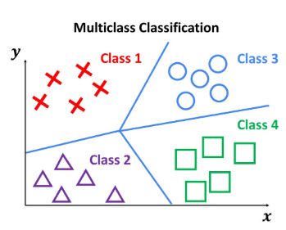
MULTICLASS CLASSIFICATION:
Multi-class classification on brain diseases involves building a model that can predict the type of brain disease based on various features or input data

Slide 7
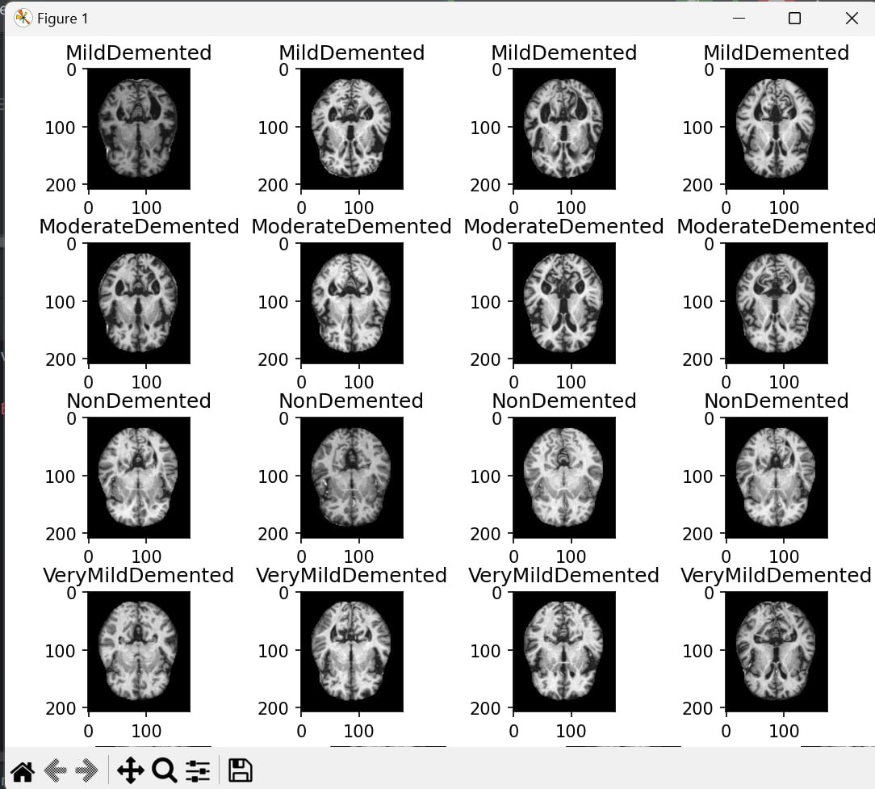
OUTPUT

Slide 8
Data Augmentation:-
Rotate images by a certain angle (e.g., 90 degrees, 180 degrees).
Helps the model become invariant to different orientations. Apply horizontal or vertical flips to images.
Introduces variations in the directionality of structures.
Zoom in or out of the images by a certain factor.
Introduces variability in the scale of brain structures.

Slide 9
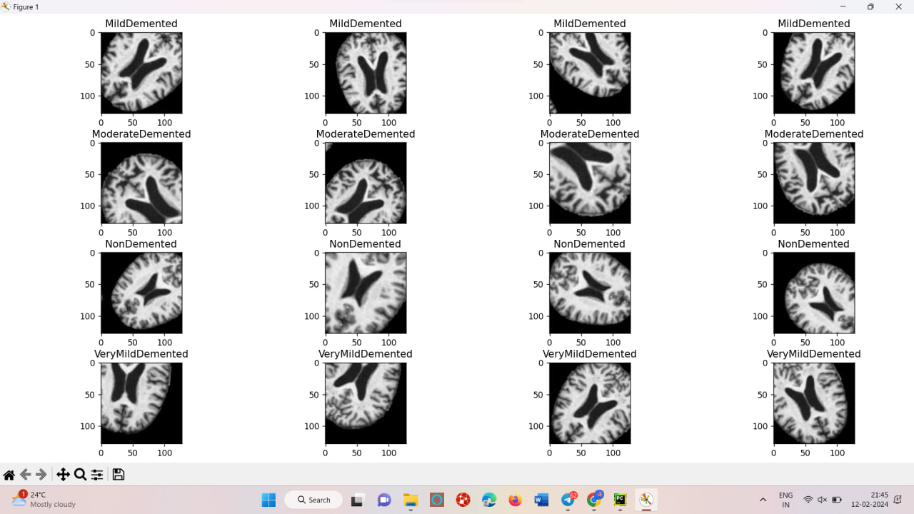

Slide 10
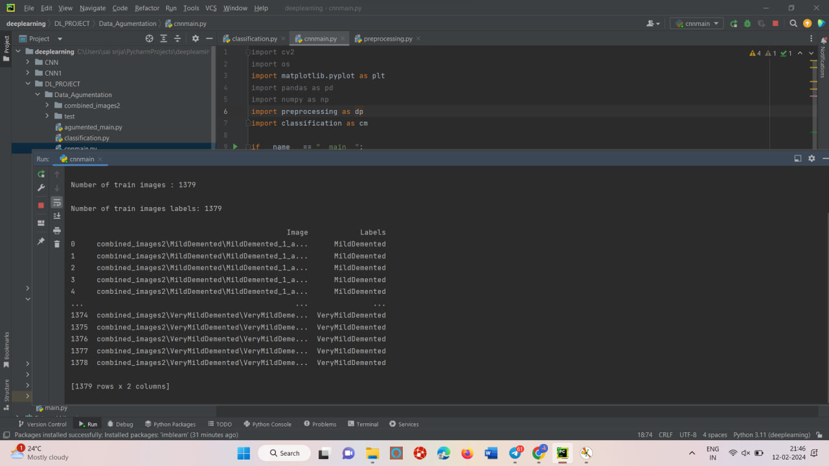

Slide 11
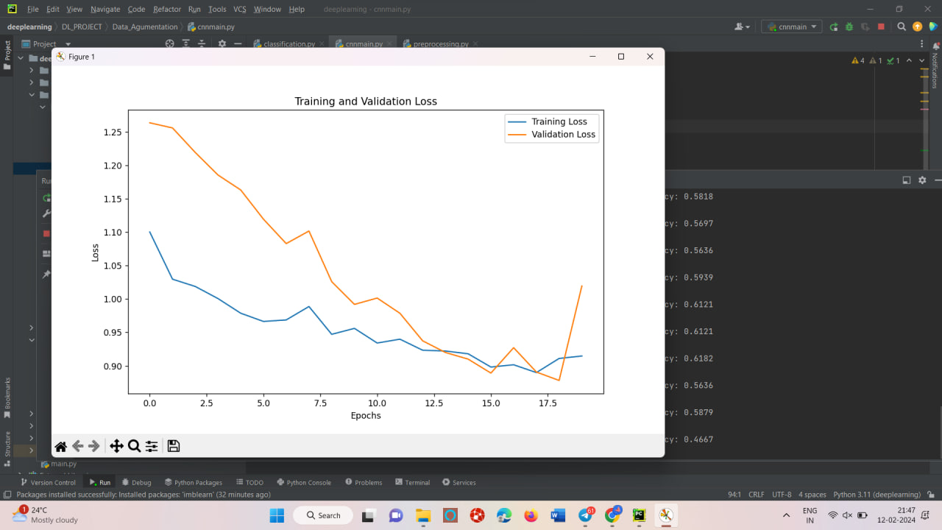
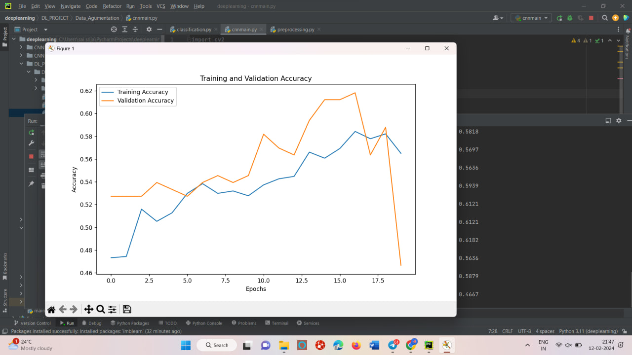

Slide 12
Normalisation:-
Neural networks used for medical image classification, including Brain Disease Classification, can be deep and complex.
Batch Normalization helps stabilize the training process by normalizing the input distributions, preventing issues like vanishing/exploding gradients.
Brain Disease Classification models may require substantial training times due to the complexity of the task.
Batch Normalization accelerates convergence, enabling the model to reach satisfactory performance levels in fewer training epochs.

Slide 13
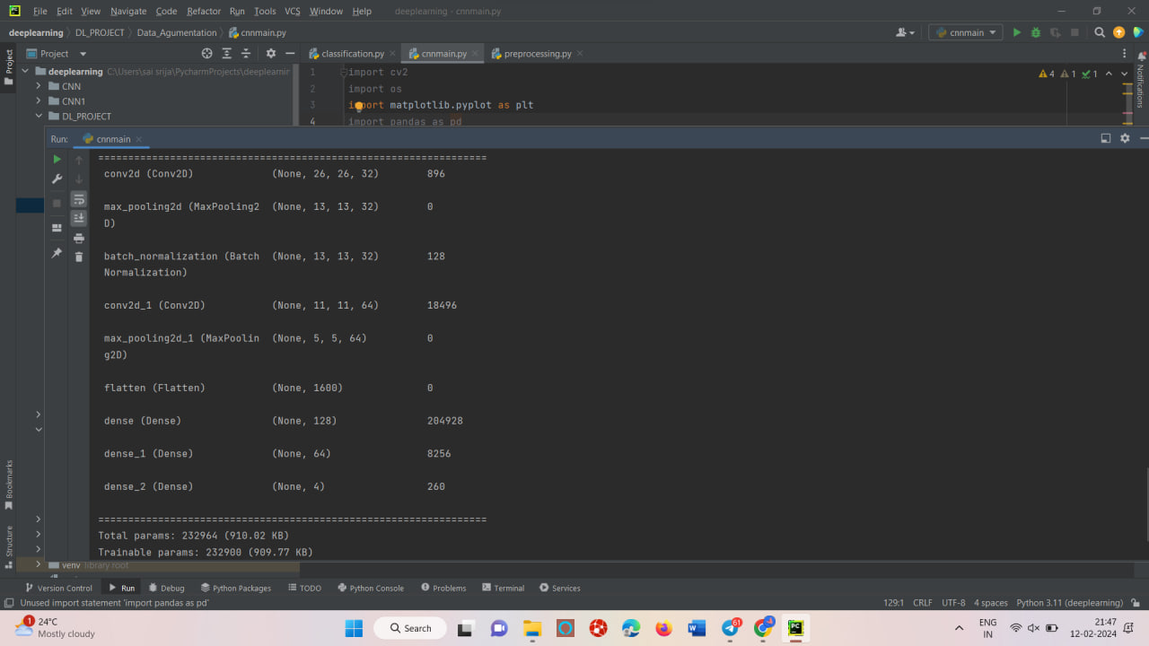

Slide 14

CNN MODEL;-
Brain Disease Classification models may require substantial training times due to the complexity of the task.
Batch Normalization accelerates convergence, enabling the model to reach satisfactory performance levels in fewer training epochs.

Slide 15
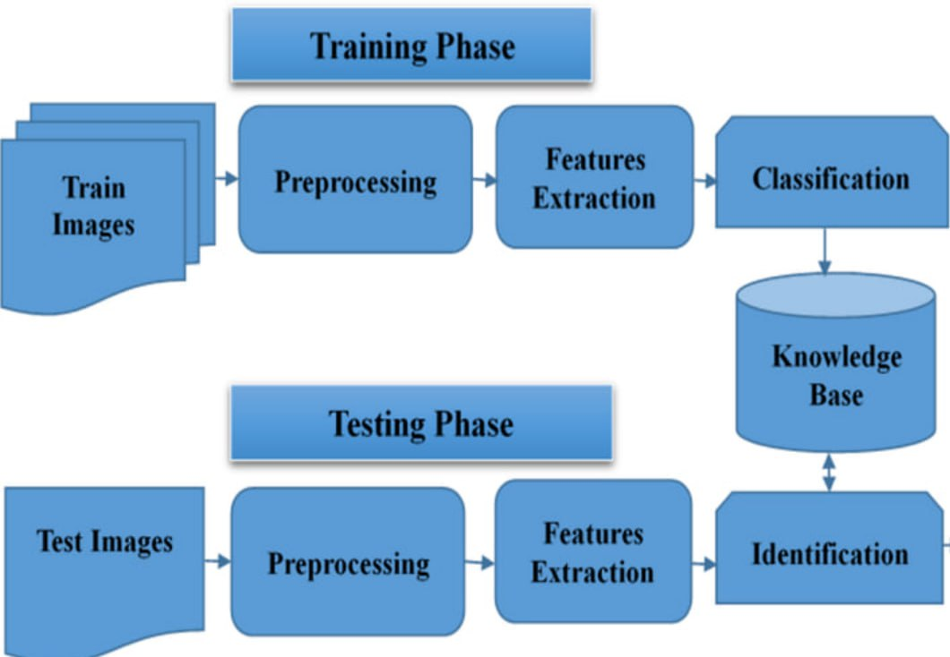
CNN MODEL ARCHITECTURE

Slide 16
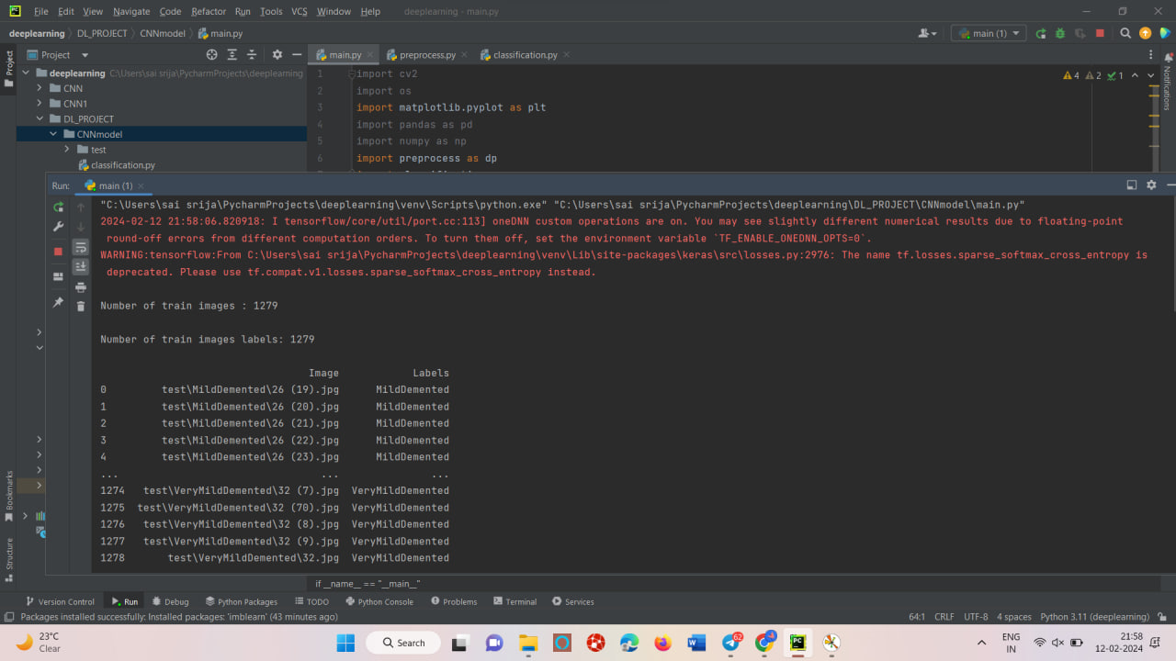
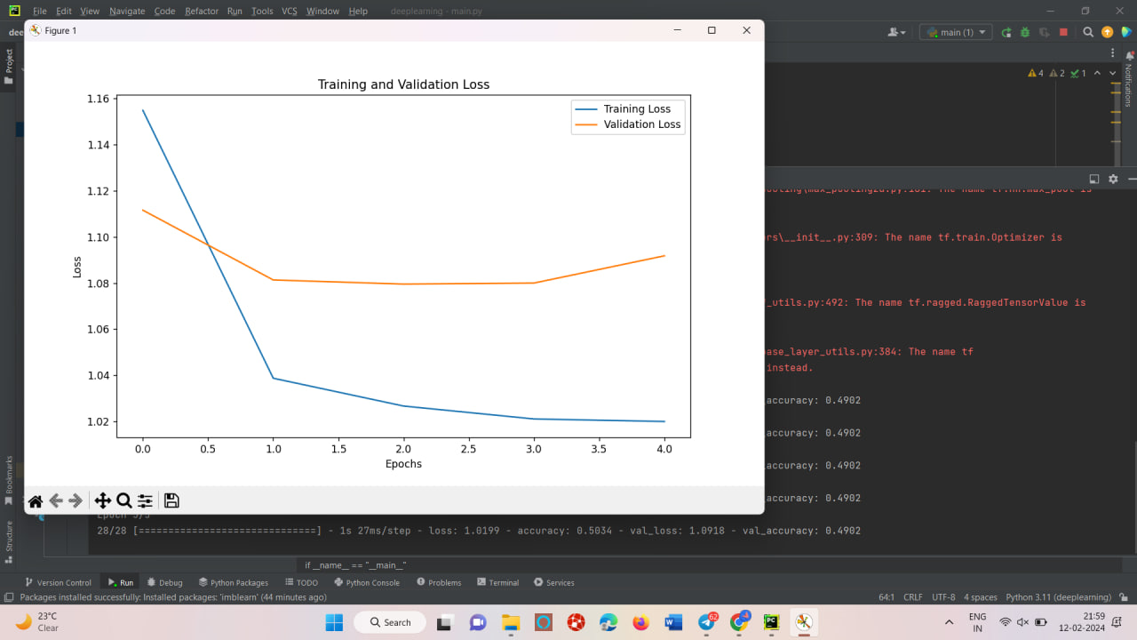

Slide 17
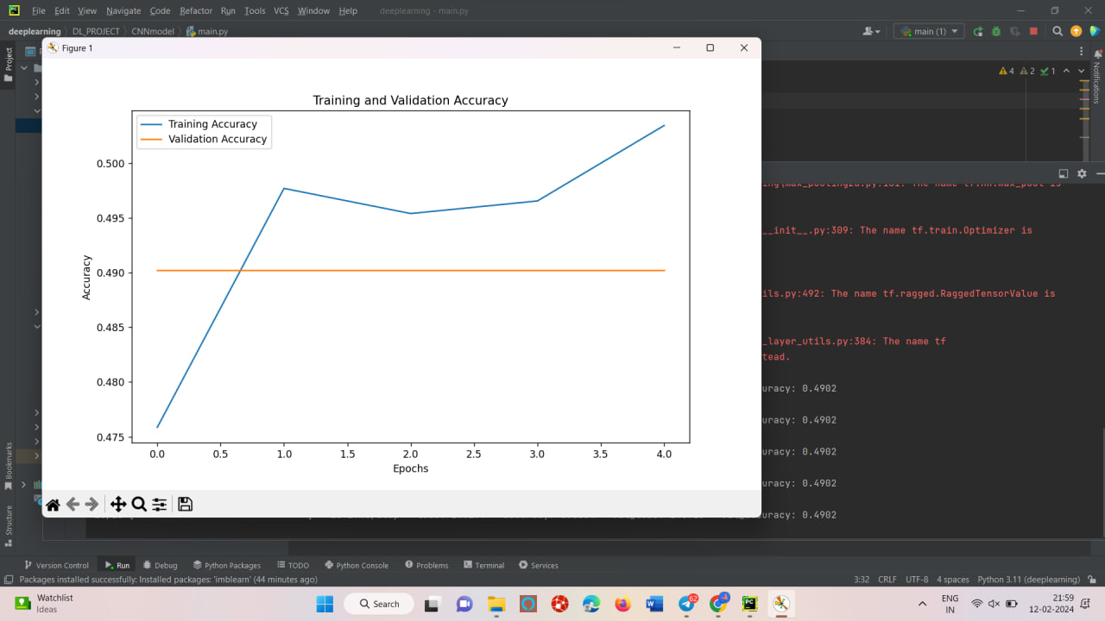
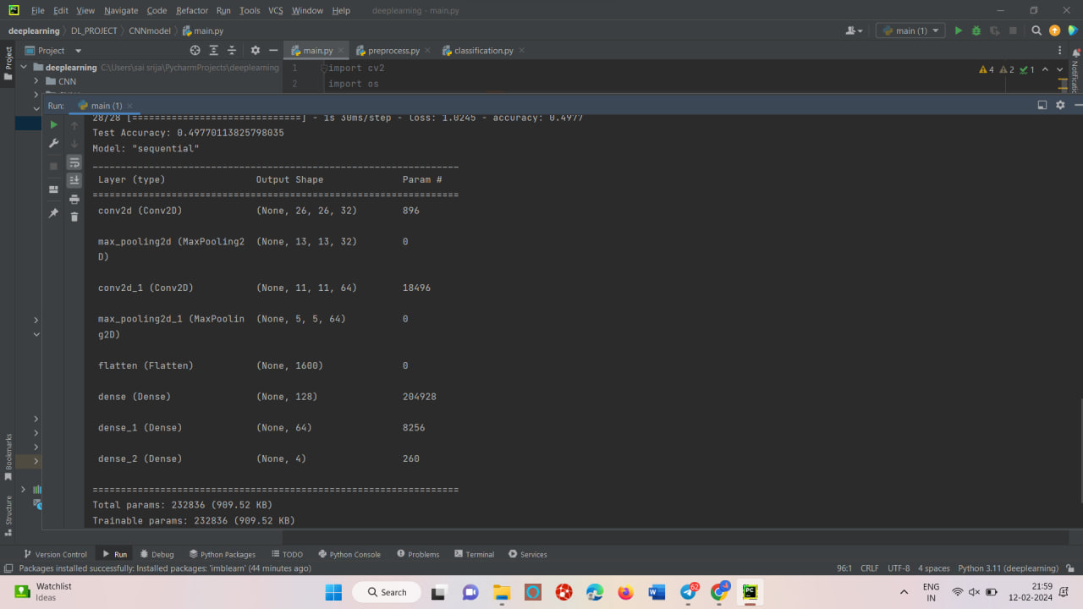

Slide 18
VGG MODEL:-
The VGG (Visual Geometry Group) model is a convolutional neural network architecture .
While the VGG model is a powerful and versatile architecture for image classification tasks, including those related to medical imaging and diagnosis

Slide 19
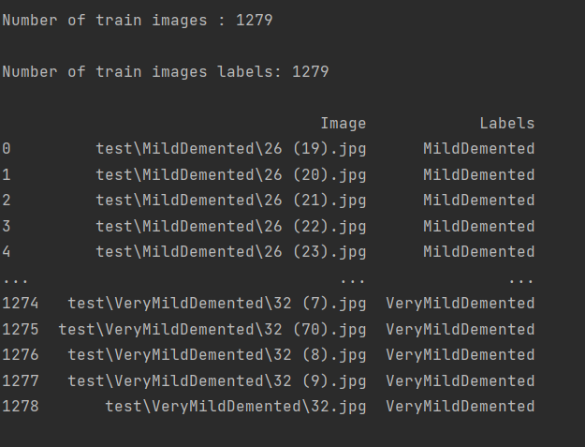
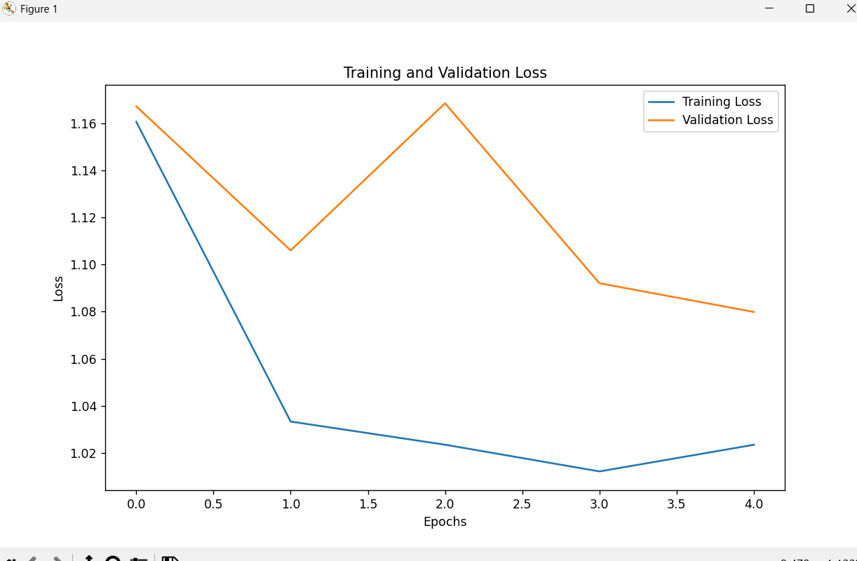

Slide 20
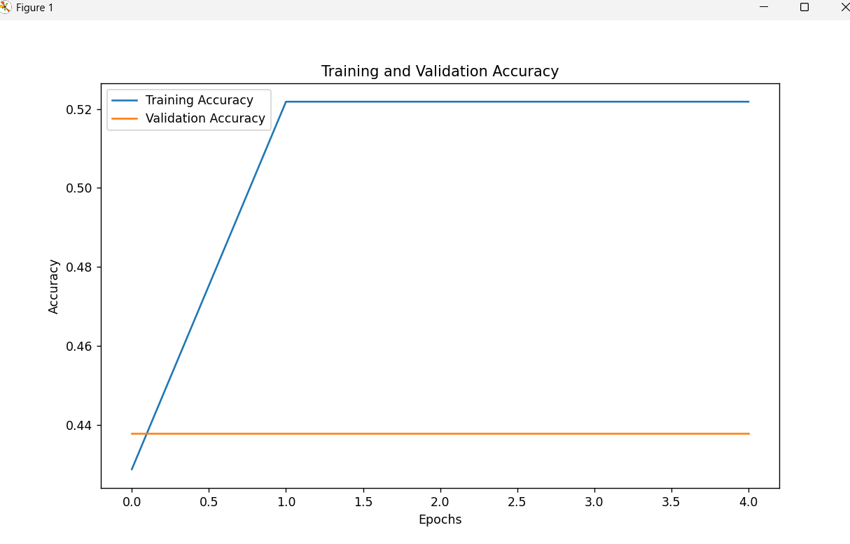
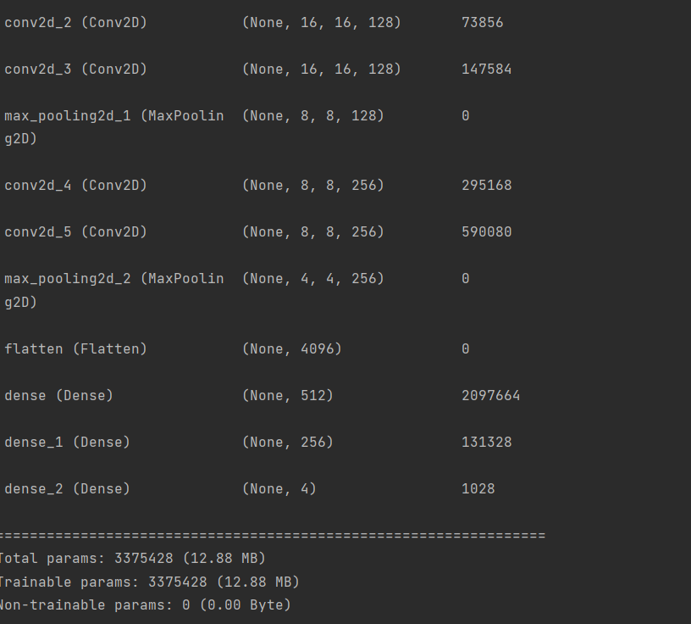

Slide 21
AutoEncoders:-
An autoencoder is a special type of neural network that is trained to copy its input to its output. For example, given an image of a handwritten digit, an autoencoder first encodes the image into a lower dimensional latent representation, then decodes the latent representation back to an image.

Slide 22
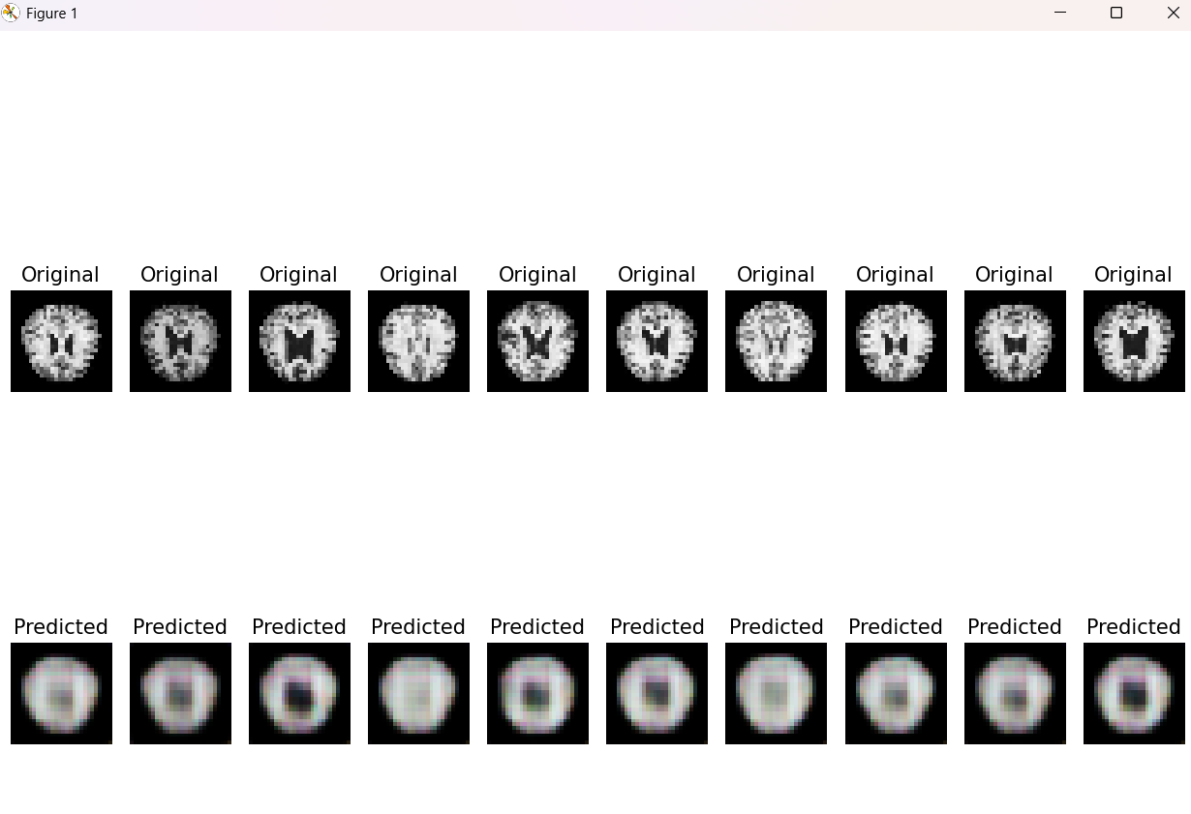
output

Slide 23
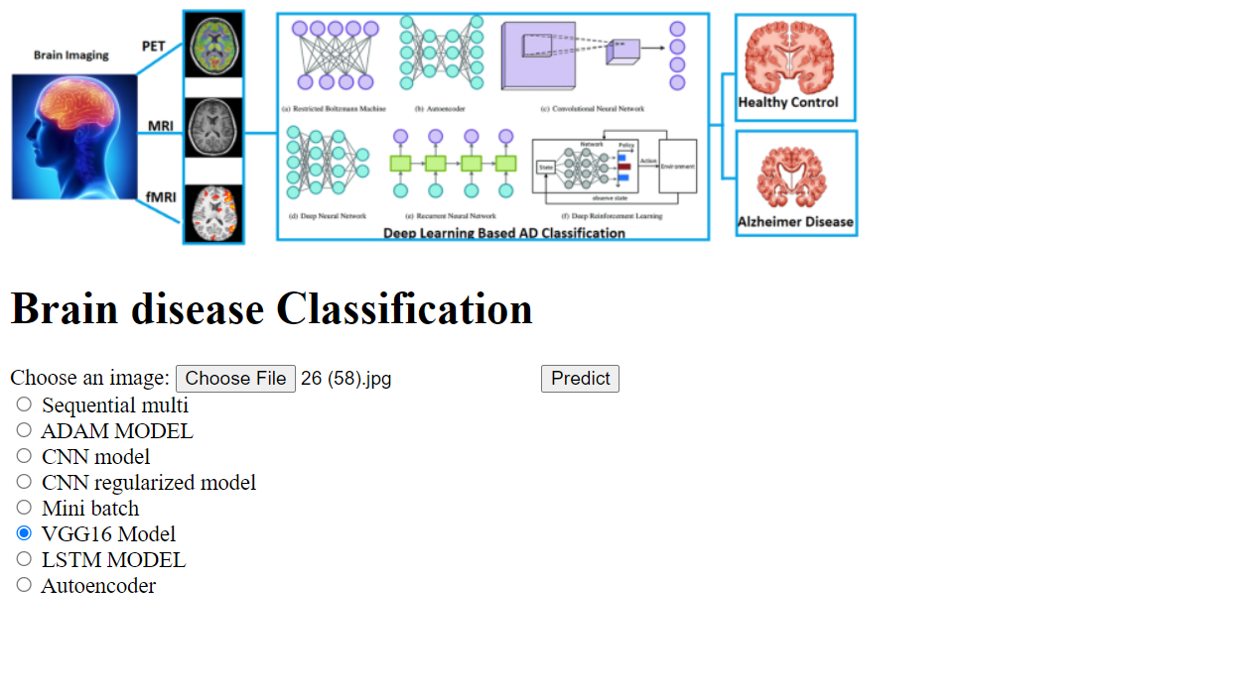
FLASK APPLICATION

Slide 24
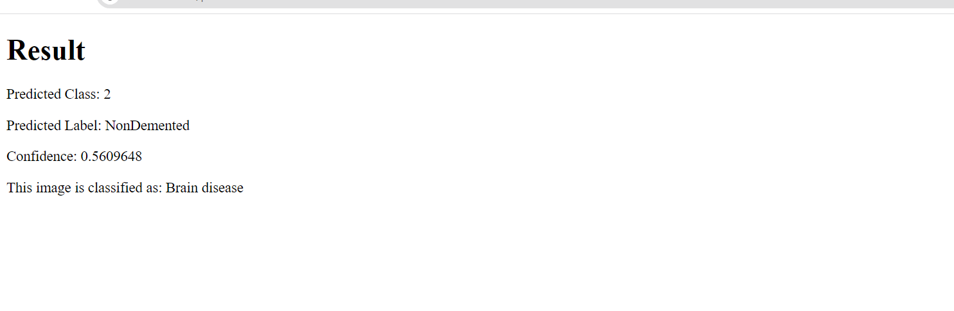
FLASK APPLICATION

Slide 25

THANK YOU

